Slide 1
Chess Application Alternative Implementation
Using Java Graphics rather than ACM Graphics

Slide 2
Notes
This note discusses the operation of this module in lesser detail allowing students to understand how it works in hopes that this will enable them to modify it properly.

Slide 3
Intentionally Incomplete Program
Students need to work on the following items.
System to move captured pieces from gamespace to storage space.
Checking if Tile Movements are all okay and no issues with placing values in and out of the Tiles exist.
Missing Graphics Jbuttons can hold an icon https://www.javatpoint.com/java-jbutton
It is recommended to have Text and an Icon on the Pieces so see this example of this https://www.tutorialspoint.com/swingexamples/create_button_with_icon_text.htm
System to employ promotion of pawns to either a Queen, Knight, Bishop, Rook
Students can do this either automatically or manually removing the pawn from the board
Reset Button to reset the board.
Addition of Container to post details like piece accessed and movement position to and captured pieces.

Slide 4
Optional Items
Movement Limitation based on pieceType
Friend or Foe Limitation for Capturing Pieces

Slide 5
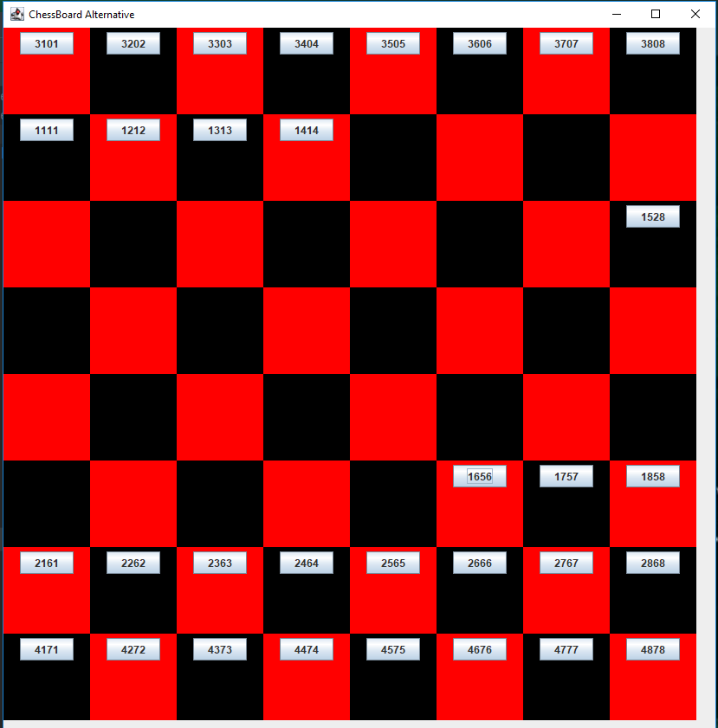
JFrame is equivalent to the Gcanvas in ACM Graphics it is the writing Space
The Jframe is called board in this program.
It has the text set to “ChessBoard Alternative”
Declarations can be found in ChessB.java
1
2
3
4
5
6
7
8
1 2 3 4 5 6 7 8

Slide 6
The javax.swing.JFrame class is a type of container which inherits the java.awt.Frame class. JFrame works like the main window where components like labels, buttons, textfields are added to create a GUI.
1
2
3
4
5
6
7
8
1 2 3 4 5 6 7 8

Slide 7
A Container was created and inserted inside the Frame it has the name of f.
Containers are an integral part of SWING GUI components. A container provides a space where a component can be located. A Container in AWT is a component itself and it provides the capability to add a component to itself. Following are certain noticable points to be considered.
1
2
3
4
5
6
7
8
1 2 3 4 5 6 7 8

Slide 8
Each Tile has its own numbering system this is found inside mouseClicked Function first half
1
2
3
4
5
6
7
8
1 2 3 4 5 6 7 8

Slide 9
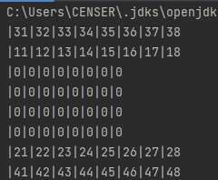
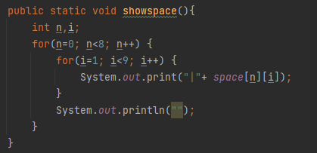
showspace()
In the past exercises I have often told students that using the System Console to aid in finding out what is taking place inside the programs memory is needed.
showspace() does this for the pieces placement

Slide 10
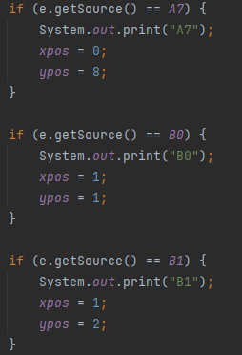
1
2
3
4
5
6
7
8
1 2 3 4 5 6 7 8

Slide 11
1
2
3
4
5
6
7
8
Writing Piece is accomplished by line 5525 shown here:
drawPiece(xpos,ypos,ObjID); space[xpos][ypos]=ObjID;
1 2 3 4 5 6 7 8

Slide 12
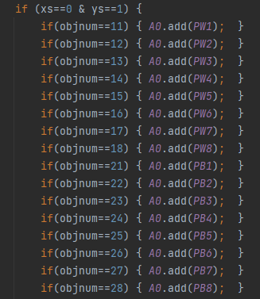
drawPiece() Method
This method is a hardwired code with 2k+ Lines since Object Names importation to declare the OBJ.add(obj) means did not work with inheritance set.
The function determines the Tile to Write into first
Second it creates the instantation to add the object to the JPanel

Slide 13
removePiece() Method
This method is a hardwired code with 2k+ Lines since Object Names importation to declare the OBJ.add(obj) means did not work with inheritance set.
The function determines the Tile to remove button from into first
Second it creates the instantation to remove the object from the JPanel

Slide 14
Each Piece has its own unique ID the last two digits (Hundreds and Thousands)
11-18 (Pawn)
21-28 (Pawn)
31,38,41,48 (Rook)
32,37,42,47 (Knight)
33,36,43,46 (Bishop)
34, 44 (Queen)
35,45 (King)

Slide 15
Each Piece has its own position information written on the first and second digit (ones and tens position)
This is extracted by using the code found inside the MouseClickedListener:
Namae = PW1.getText(); ObjConvID = Integer.parseInt(Namae); ObjID = convertvalues(ObjConvID, 0); ObjPosY = convertvalues(ObjConvID, 2); ObjPosX = convertvalues(ObjConvID, 1);

Slide 16
Once a piece is clicked then its image is removed using the removePiece() Method.

